Slide 1
Simulation Link-State Routing Protocol
Sagar Prakash Mane
CWID : A20379756
Illinois Institute of Technology

Slide 2
Introduction
The basic concept of link-state routing is that every node constructs a map of the connectivity to the network, in the form of a graph, showing which nodes are connected to which other nodes.
Link state routing protocols are based on Shortest Path First(SPF) algorithm to find the best path between source and router

Slide 3
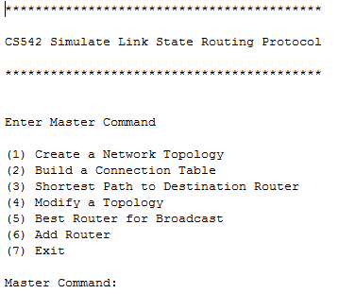
Welcome Screen
Run the program in Eclipse or in cmd using command java –jar cs542.jar
It will display all options and promt for master command for process.

Slide 4
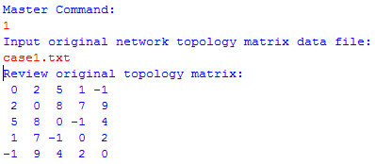
Creating Network Topology
Generating Connection Table
Shortest Path
Add Router
Remove Router
Best Router
Exit
Enter master command 1, program will asked for the file name
If file name is valid or exits, then file data is displayed and prompt for next command

Slide 5
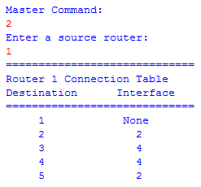
Creating Network Topology
Generating Connection Table
Shortest Path
Add Router
Remove Router
Best Router
Exit
Enter master command 2, program will prompt for source router number.
Connection table generated, if there is no path from source router to destination router
then NONE will displayed

Slide 6
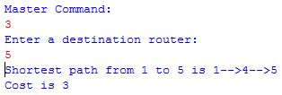
Creating Network Topology
Generating Connection Table
Shortest Path
Add Router
Remove Router
Best Router
Exit
Enter master command 3, program will prompt for destination router number.
Shortest path display from source router to destination router along with cost.

Slide 7
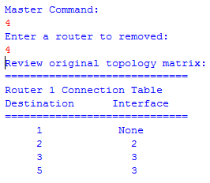
Creating Network Topology
Generating Connection Table
Shortest Path
Add Router
Remove Router
Best Router
Exit
Enter master command 4, program will asked for remove router number.
New connection table display after removal of router.

Slide 8

Creating Network Topology
Generating Connection Table
Shortest Path
Add Router
Remove Router
Best Router
Exit
Enter master command 5.
Best router is displayed along with cost.

Slide 9
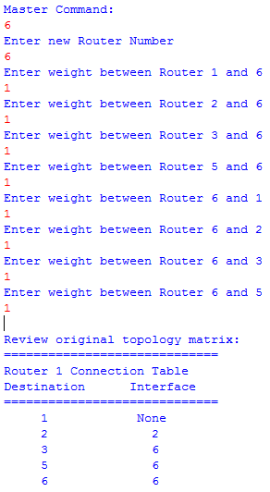
Creating Network Topology
Generating Connection Table
Shortest Path
Add Router
Remove Router
Best Router
Exit
Enter master command , program prompt for new
router number and distance to each router.
Connection table is generated after adding new router.

Slide 10

Creating Network Topology
Generating Connection Table
Shortest Path
Add Router
Remove Router
Best Router
Exit
Enter master command 7.
Program exits with good by message.

